Slide 1





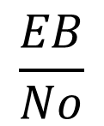



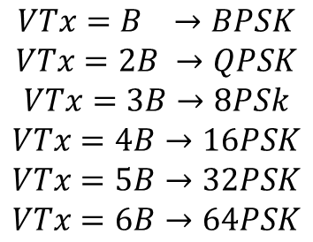
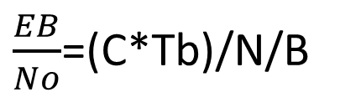

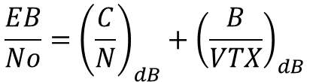
BER-->EB/No y Cantidad/B
$$\frac{EB}{No}$$
Energía de bit
N=KTB
Potencia de la Señal
$$K=1.38∗{10}^{−23}$$
$$T=300K$$
$$B=ancho de banda$$
$\frac{EB}{No}$=(C*Tb)/N/B
$$VTx=B →BPSK$$
$$VTx=2B →QPSK$$
$$VTx=3B→8PSk$$
$$VTx=4B→16PSK$$
$$VTx=5B→32PSK$$
$$VTx=6B→64PSK$$
$$B=\frac{VTx}{4}=25Mbps$$
$$C=\frac{C}{N}+N$$
$$Tb=\frac{1}{VTx}$$
$$N_{dBW}=−12.98dBw$$
$$\frac{EB}{No}=\frac{CTb}{N/B}=\frac{C}{N}∗\frac{B}{VTX}$$
$$\frac{C}{N}$$
$$\frac{EB}{No}={\left(\frac{C}{N}\right)}_{dB}+{\left(\frac{B}{VTX}\right)}_{dB}$$
SNR
M-> Cantidad de Bits que maneja el sistema

Slide 2

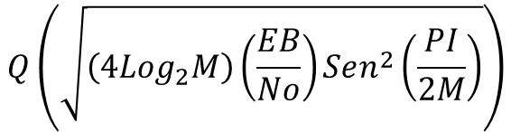

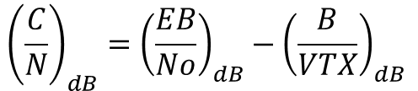

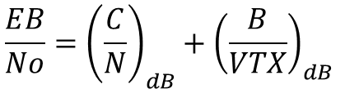


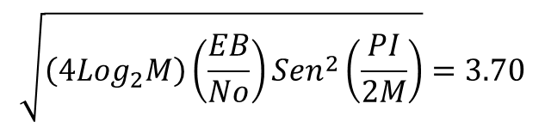
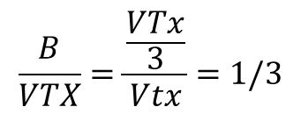
Informe PCM=40%
Taller =5%
55%=Taller N4 y TNN
$$BER={10}^{−4}$$
8-DPSK
Q(X)=BER=10^-4
20Mbps=VTx
$$\frac{EB}{No}={\left(\frac{C}{N}\right)}_{dB}+{\left(\frac{B}{VTX}\right)}_{dB}$$
$$Q\left(\sqrt{\left(4Log_{2}M\right)\left(\frac{EB}{No}\right)Sen^{2}\left(\frac{PI}{2M}\right)}\right)$$
$$VTx=3B$$
$$\sqrt{\left(4Log_{2}M\right)\left(\frac{EB}{No}\right)Sen^{2}\left(\frac{PI}{2M}\right)}=3.70$$
$$B=\frac{VTx}{3}=\frac{20M}{3}$$
$$\frac{B}{VTX}=\frac{\frac{VTx}{3}}{Vtx}=1/3$$
$$\frac{EB}{No}=4.98dB$$
$${\left(\frac{C}{N}\right)}_{dB}={\left(\frac{EB}{No}\right)}_{dB}−{\left(\frac{B}{VTX}\right)}_{dB}$$
$$\frac{1}{3}=−0.477dB$$
C/N=5.4645306416606

Slide 3
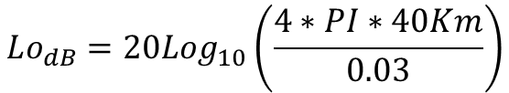







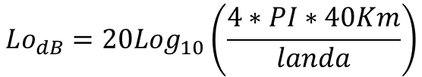





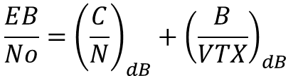
$$B=\frac{VTx}{4}=25Mbps$$
$$C_{dBW}=PIRE+GRx_{dB}−Lo_{dB}$$
$$Gtx=13dB=20$$
$$Lo_{dB}=20Log_{10}\left(\frac{4∗PI∗40Km}{landa}\right)$$
$$N_{dBW}=−129.85dBw$$
$$Lo_{dB}=20Log_{10}\left(\frac{4∗PI∗40Km}{0.03}\right)$$
$$Lo_{dB}=144.48dB$$
$$Landa=\frac{3∗{10}^{8}}{10∗{10}^{9}}=0.03$$
$$C_{dBW}=PIRE+GRx_{dB}−Lo_{dB}$$
$$\frac{EB}{No}={\left(\frac{C}{N}\right)}_{dB}+{\left(\frac{B}{VTX}\right)}_{dB}$$
$$C_{dBW}={46}_{dBm}+{13}_{dB}−{144.48}_{dB}$$
$$\frac{EB}{No}={\left(14.37\right)}_{dB}+{\left(−6.02\right)}_{dB}$$
$$C_{dBw}=−{115.48}_{dBw}$$
$$\frac{EB}{No}={\left(8.37\right)}_{dB}$$
$$\frac{C}{N}=C−N=−{115.48}_{dBw}−{\left(−129.85\right)}_{dBw}={14.37}_{dB}$$
$$\frac{EB}{No}=6.83→BER=1.58∗{10}^{−1}$$
$$Eb/no_{dB}=10Log_{10}(Eb/no_{Lineal})$$

Slide 4
